Slide 1

NYC Taxis and For Hire Trip
Heba Ahmed

Slide 2

Data Source
https://www1.nyc.gov/site/tlc/about/tlc-trip-record-data.page
NYC Taxi and Limousine Commission (TLC) for the following ride types:
Yellow Taxi
Green Taxi
For-Hire Vehicle (Uber, Lyft and others)
I selected the data for December 2019
Original Data Size (22 Million Records)

Slide 3
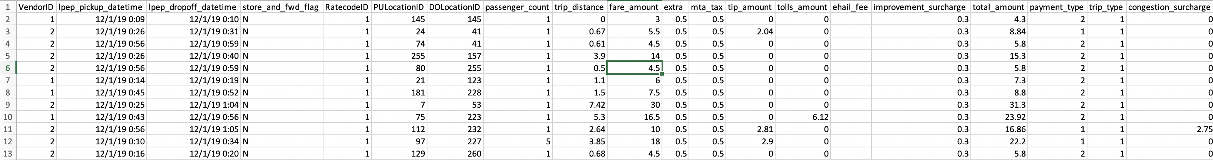
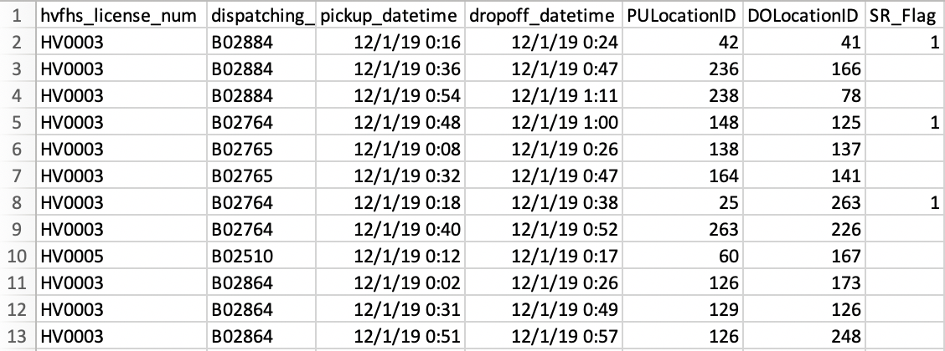
Data Processing
Data was provided from the website as CSV files.
Python was used to process the files and store them in a Postgres Database.
I did do random sampling using python of 1% of the original dataset to enhance the performance of Tableau when retrieving the large data set.

Slide 4
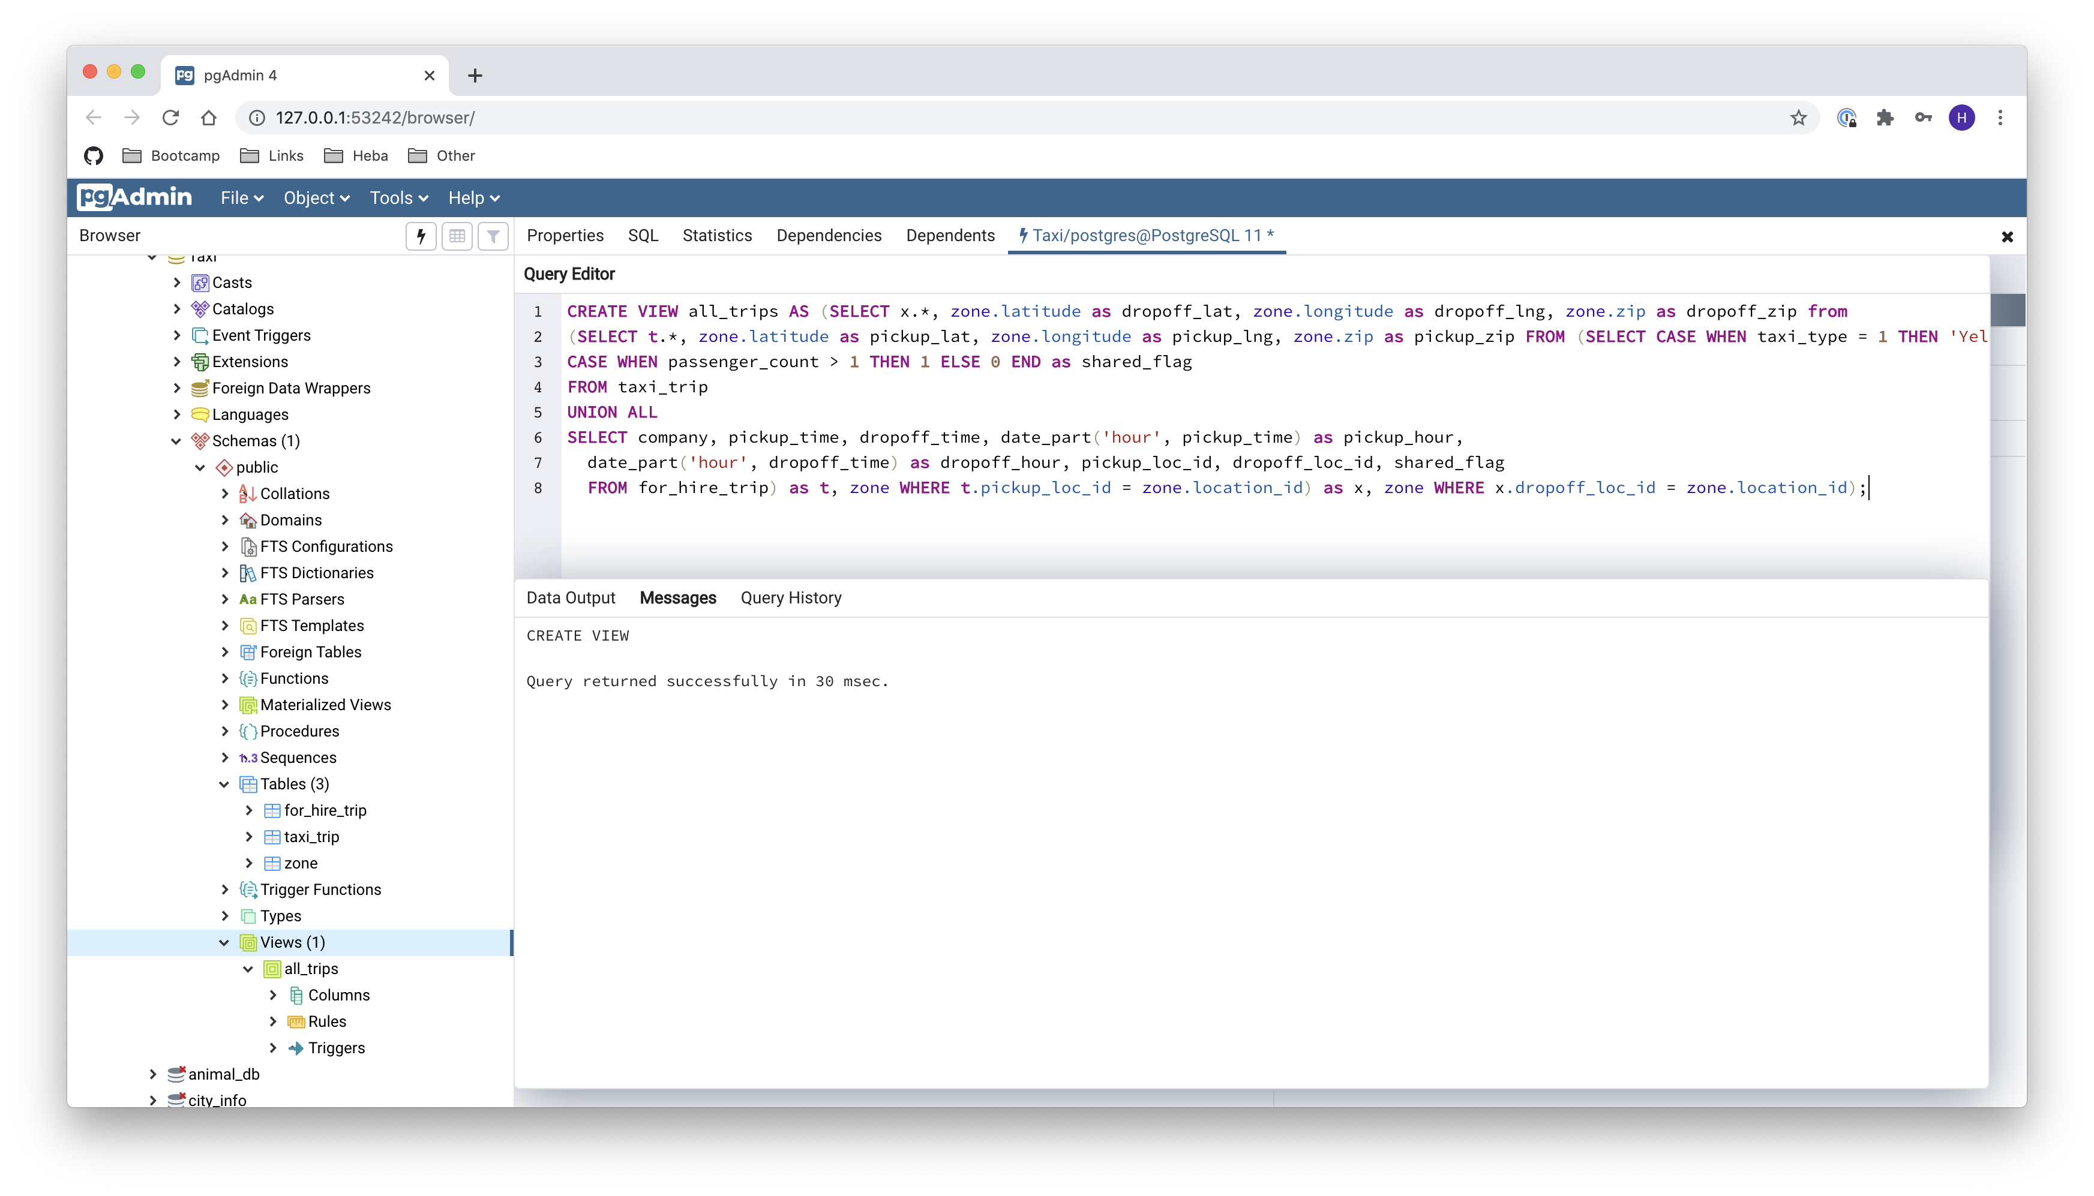
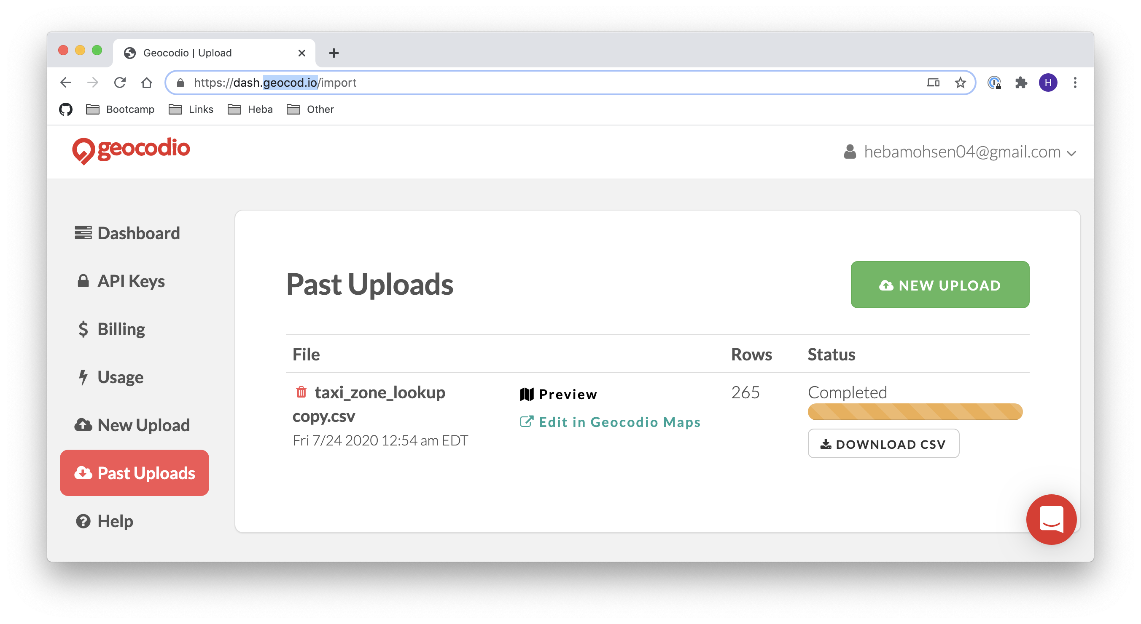
Data Processing
Combined tables in Postgres and added a View to enable Tableau to access the combined Taxi and For-Hire data as a combined table.
The data included pickup and drop-off addresses, performed Geocoding using geocod.io website to generate the latitude and longitude for each address.

